Slide 1



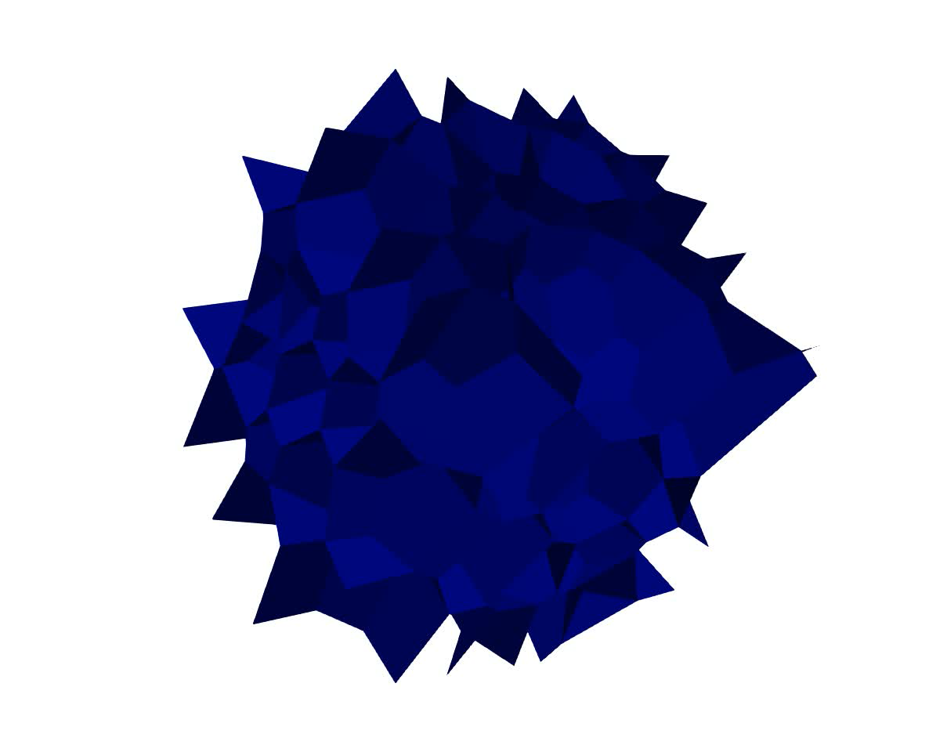
MFront User Meeting 2024 Micromechanical modelling of closed-cell foams under compression by coupling FEniCS with MFront
L. Liu¹, F. Liu¹, D. Zenkert², M. Åkermo², M. Fagerström¹
¹Chalmers University of Technology, Sweden ²KTH Royal Institute of Technology, Sweden
Email address: l.liu@chalmers.se
Notes:
Reveal the underlying mechanisms, with the power of coupling

Slide 2
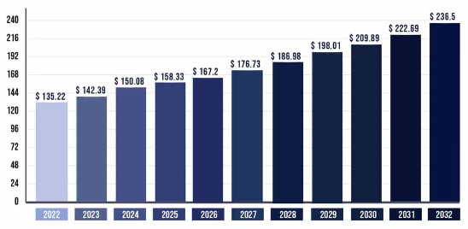
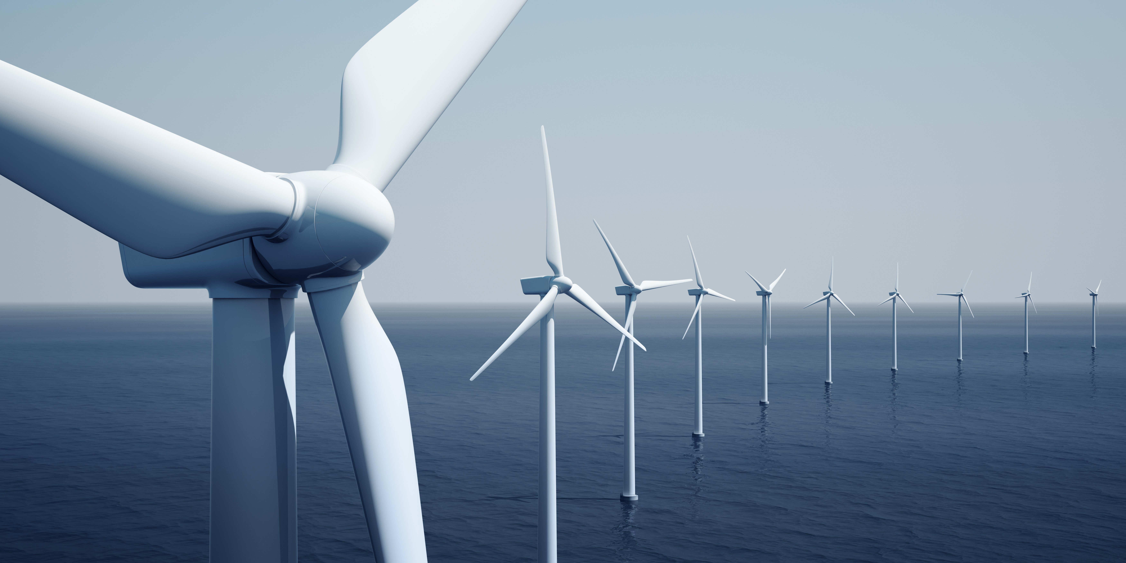

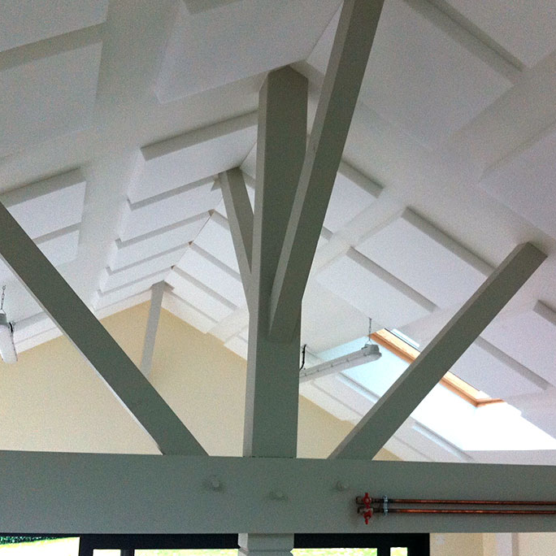
Introduction
Polymer foam market (in Billion)
Closed-cell foams
Excellent mechanical properties
Low density
High stiffness and strength
Energy absorption
Acoustic isolation
www.precedenceresearch.com
www.amiplastics.com
www.sportsdirect.com
www.soniflex.com
Notes:
A bit on background
Still growing

Slide 3
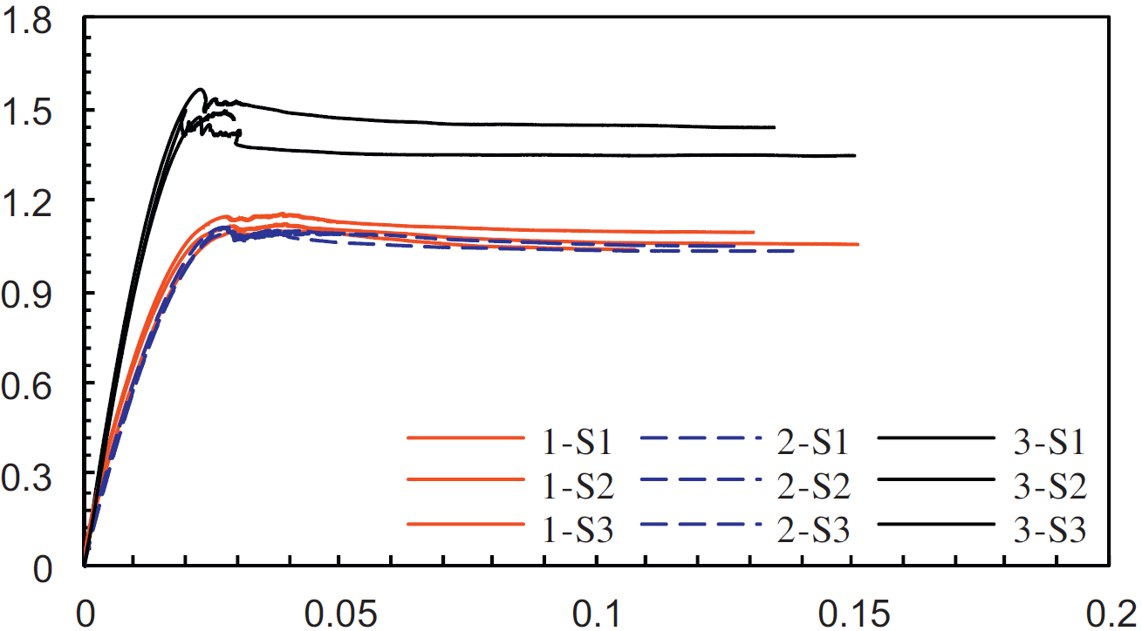
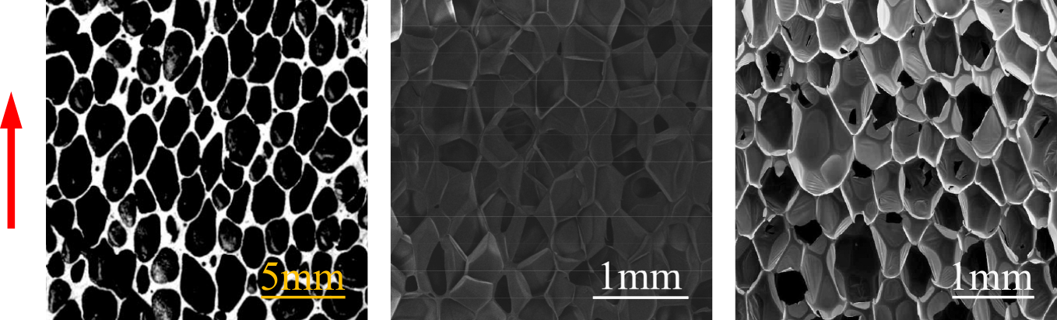
PVC foam compression
Underlying mesostructures
Large number of cells
Thin cell walls
Cell shape anisotropy
Stress [MPa]
Shafiq et al., 2015
Strain [-]
Aluminium
PVC
PIR
Foam rise
Mu et al., 2010
Tang et al., 2022
Andersons et al., 2010
Notes:
For load-bearing applications, compressive behaviour

Slide 4
What are the key deformation mechanisms governing the anisotropic compressive behaviour?
Notes:
To date, not fully understood, low-density foams

Slide 5
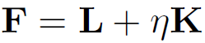
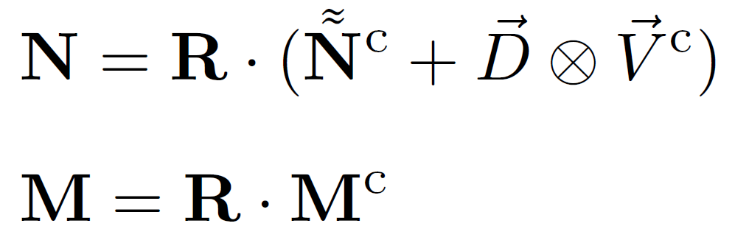
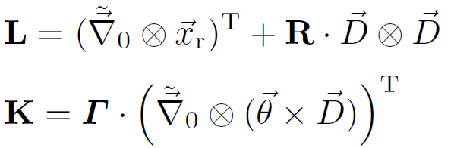
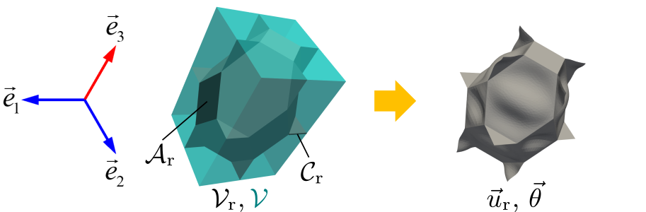
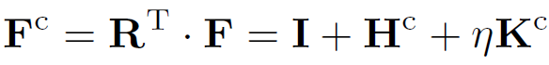
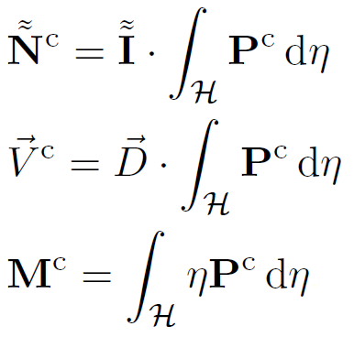
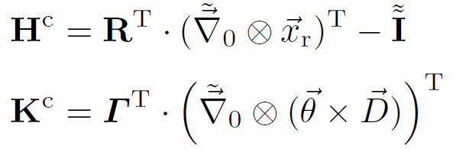
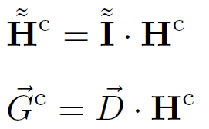
RVE problem description
Finite rotation shell formulation
Kinematics
Stress resultants
with
with
Campello et al., 2003
Notes:
Single cell is sketched as an example
Paramertized
From initial to current
Constitutive, back-rotated
Details

Slide 6
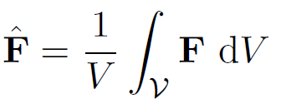
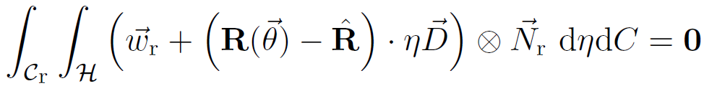
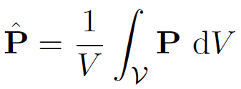
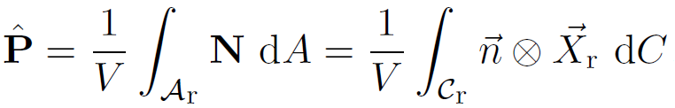
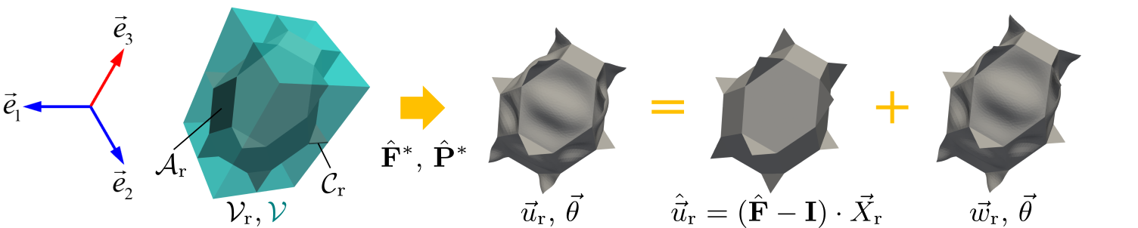
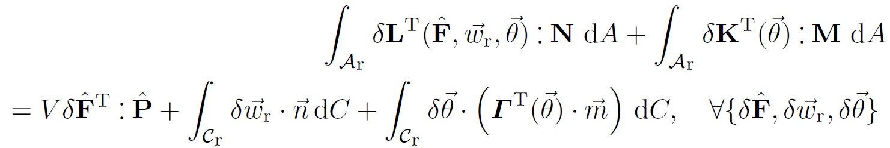
Mixed stress-strain driven formulation
Classical homogenization for mesoscale shell problem
Weak form
Notes:
RVE problem, specific stress state
Classical homogenization, Hill-Mandel
Decompose
Resulting weak form, P appears like

Slide 7
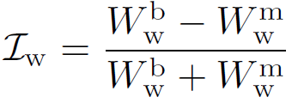
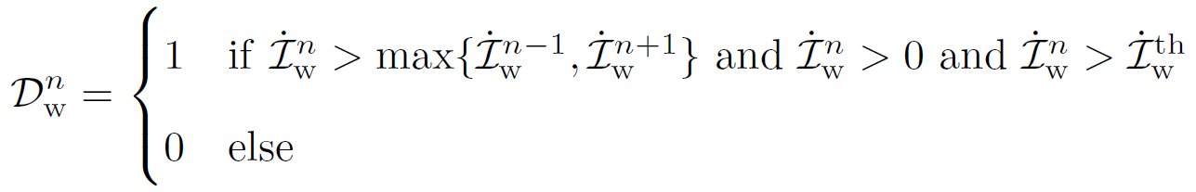
Quan. method of cell wall behaviour
Strain energy partitioning indicator
Membrane energy
Bending energy
1
0
Buckling occurrence detector
Partitioning indicator rate
-1
Time
Time
Notes:
To identify
Low-density

Slide 8
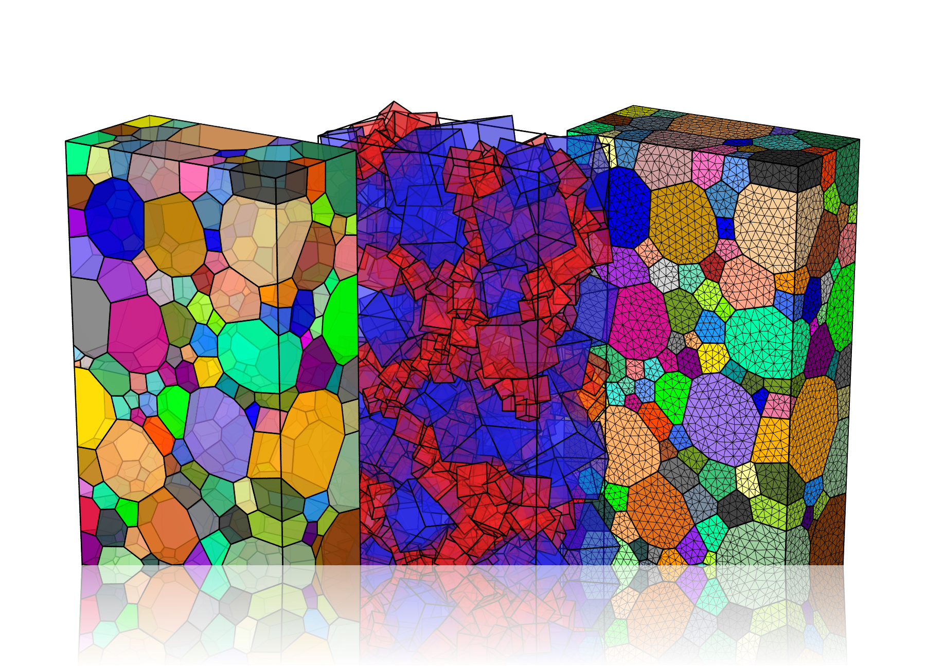

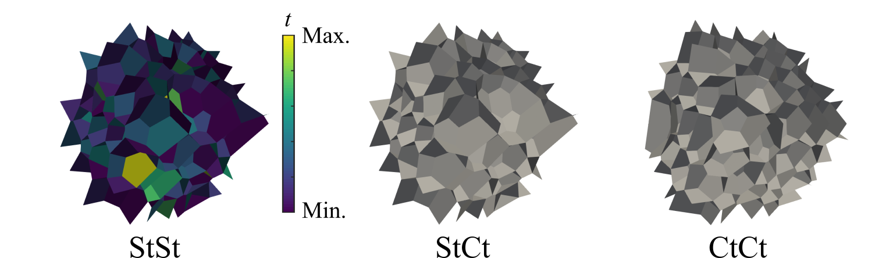
RVE simulation setup
Zhou et al., 2023
Geometrical model configurations
Divinycell foam grade H100
Mesostructural stochastics
Parameter | Symbol | H100
RVE dimension 1 | L₁ | 1.5 [mm]
RVE dimension 2 | L₂ | 1.5 [mm]
RVE dimension 2 | L₃ | 1.5 [mm]
Cell shape anisotropy | R | 1.2 [-]
Cell equivalent diameter | (µ^{d},σ^{d}) | (0.35,0.10) [mm]
Cell wall thickness | (µ^{t},σ^{t}) | (0.0115,0.0059) [mm]
Nominal relative density | ρ/ρ_{r} | 0.0714 [-]
+
Neper
Complexity
Notes:
H100 as an example, global directions
A side study, fewer stochastics

Slide 9
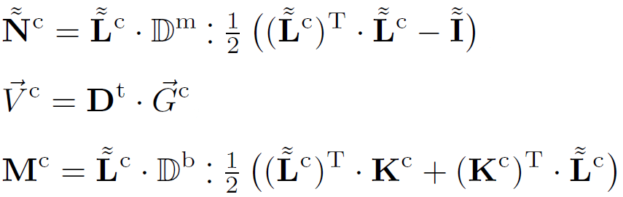
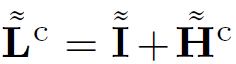
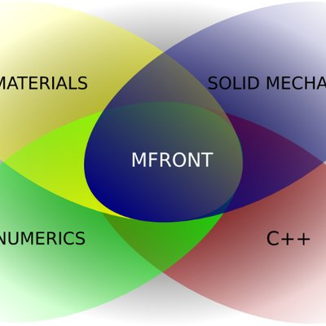
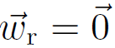
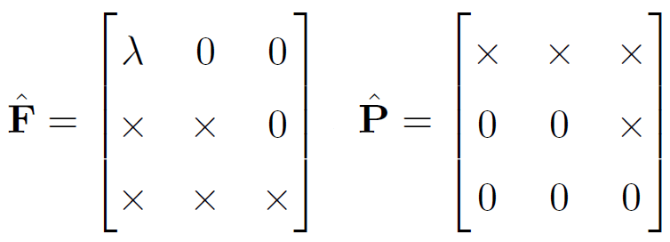

Material model
Finite-strain isotropic elasticity for shell problem
with
Zhou et al., 2023
Parameter | Symbol | PVC
Young’s modulus | E | 2700 [MPa]
Poisson’s ratio | ν | 0.38 [-]
Boundary conditions and loads
Fully prescribed boundary conditions
Uniaxial compression
Disp. fluctuations
+
Notes:
Have not yet managed, explain why later, sufficient for low-density foams upon failure
Fluctuations are supressed
Unprescribed, non-diagonal also prescribed

Slide 10
Implementation
MFront
@DSL DefaultGenericBehaviour;
@Behaviour finiteRotationElasticityShellLF;
@ModellingHypothesis PlaneStress;
// Specify the generalized strains and stresses
@Gradient DeformationGradientTensor Fmm;
Fmm.setEntryName("MembraneDeformationGradient");
…
// Specify the tangent stiffness
@TangentOperatorBlocks{∂Nmm∕∂ΔFmm, ∂Nss∕∂Δess, ∂Mbb∕∂Δkbb, ∂Ndd∕∂Δedd};
// Specify the material parameters
@MaterialProperty stress E;
E.setGlossaryName("YoungModulus");
@MaterialProperty real nu;
nu.setGlossaryName("PoissonRatio");
…
// Specify the internal variables
@StateVariable length th;
th.setEntryName("Thickness");
// Specify the local variables
@LocalVariable stress lambda;
@LocalVariable stress mu;
…
// Initialize several local variables
@InitLocalVariables{
lambda = computeLambda(E,nu);
mu = computeMu(E,nu);
…
}
// Compute the stresses
@Integrator{
// Specific treatment due to plane stress
Fmm(2) = 1.;
const auto Fmm1 = eval(Fmm + ΔFmm);
const auto emm = computeGreenLagrangeTensor(Fmm1);
Smm = th*(lambda_ps*trace(emm)*Stensor::Id()+2.*mu*emm);
Nmm = Fmm1 * Smm;
…
}
// Compute the tangent stiffness
@TangentOperator{
static_cast<void>(smt);
const auto Delmm = th*(lambda_ps*Stensor4::IxI()+2.*mu*Stensor4::Id());
…
∂Nmm∕∂ΔFmm = convert<FiniteStrainBehaviourTangentOperatorBase::DPK1_DF,
FiniteStrainBehaviourTangentOperatorBase::DS_DEGL>(Delmm, Fmm, Fmm1, σmm);
…
}

Slide 11
FEniCS
# Upload the initial strains to the material data manager
mat.s1.gradients[:, 0:5] = Fmm.vector().get_local().reshape((mat.n, 5))
…
# Integrate the material behaviour
it = mgis_bv.IntegrationType.IntegrationWithConsistentTangentOperator
mgis_bv.integrate(mat, it, 0, 0, mat.n)
# Download the initial stresses and tangent stiffness from the material data manager
Nmm.vector().set_local(mat.s1.thermodynamic_forces[:, 0:5].flatten())
Nmm.vector().apply("insert")
…
Ctmm.vector().set_local(mat.K[:,0:25].flatten())
Ctmm.vector().apply("insert")
…
import mgis.behaviour as mgis_bv
…
from rotation_parametrization import ExponentialMap
…
# Specify the modelling hypothesis
hp = mgis_bv.Hypothesis.PlaneStress
# Load the defined material behaviour file
bv = mgis_bv.load('src/libBehaviour.so','finiteRotationElasticityShellLF',hp)
# Set up the material data manager
mat = mgis_bv.MaterialDataManager(bv, ngs)
…
for s in [mat.s0, mat.s1]:
mgis_bv.setMaterialProperty(s, "YoungModulus", E)
…
# Upload the current strains to the material data manager
mat.s1.gradients[:, 0:5] = Fmm.vector().get_local().reshape((mat.n, 5))
…
# Integrate the material behaviour
it = mgis_bv.IntegrationType.IntegrationWithConsistentTangentOperator
mgis_bv.integrate(mat, it, 0, 0, mat.n)
# Download the current stresses and tangent stiffness from the material data manager
Nmm.vector().set_local(mat.s1.thermodynamic_forces[:, 0:5].flatten())
Nmm.vector().apply("insert")
…
Ctmm.vector().set_local(mat.K[:,0:25].flatten())
Ctmm.vector().apply("insert")
…
Numerical tours of continuum mechanics using FEniCS
comet-fenics.readthedocs.io
Notes:
Register

Slide 12
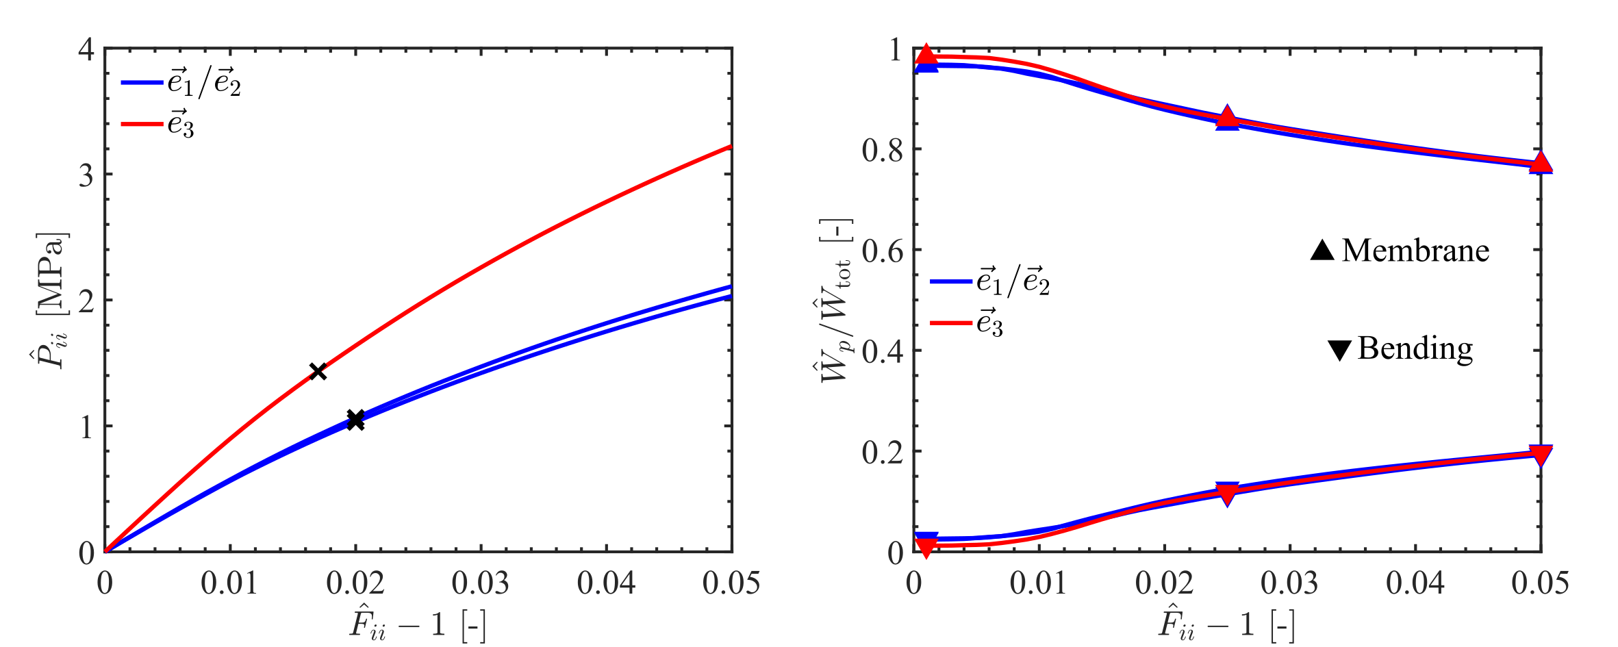
RVE simulation results
Effective responses under compression
Stress
Strain energy fractions
Notes:
Global directions
Apparently higher, anisotropic, plateau region is absent
Membrane mode dominates, bending after stiffness reduction

Slide 13
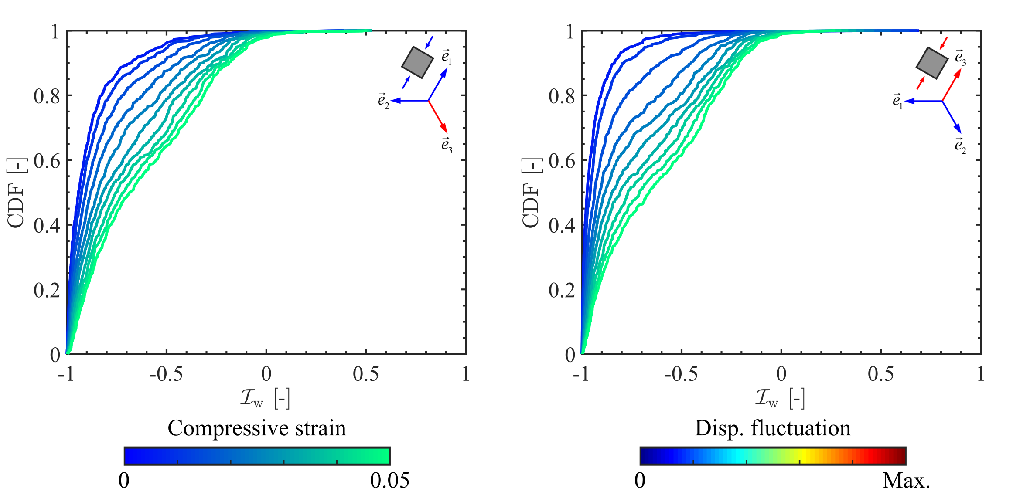
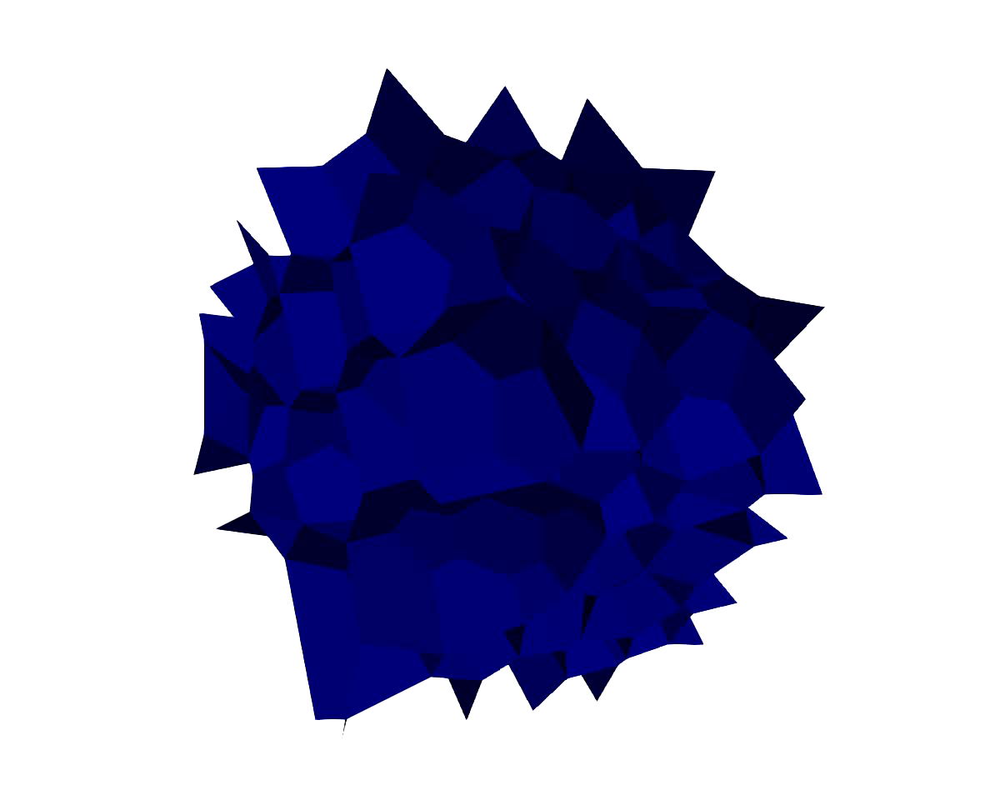

Cell wall behaviour
Transverse
Foam rise
Notes:
To rationalize
Most cell walls deform first by stretching

Slide 14
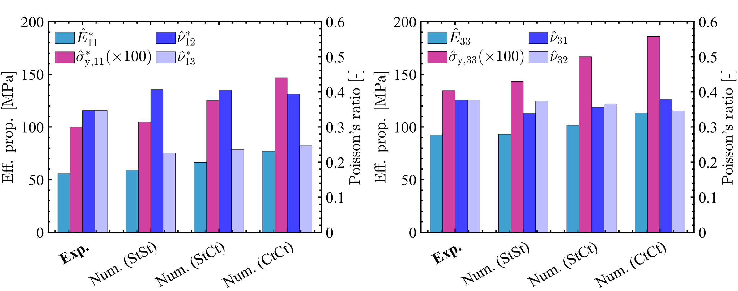
Model set | Cell size | Cell wall thickness
StSt | Stochastics | Stochastics
StCt | Stochastics | Constant
CtCt | Constant | Constant
Effective compressive properties
Transverse
Foam rise
Complexity
Complexity
Notes:
Experimental data as a reference
With different, great agreement
Modulus, strength
Poisson’s ratio

Slide 15
Conclusions
Deformation mechanisms
Cell wall stretching dominates the initial elastic region
Bending gets crucial only after failure
Mesostructural stochastics
Important to be accounted for
More stochastics result in lower strength
+
Thanks to the customization and flexibility of FEniCS and MFront!

Slide 16
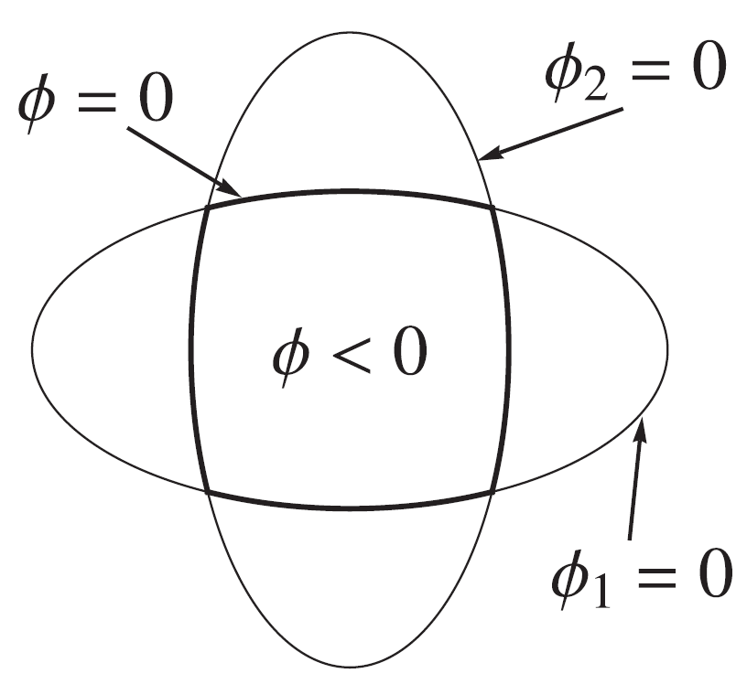
Ongoing work
Finite-strain isotropic elasto-plasticity for shell problem
Ilyushin-Shapiro two-surface yield function
Membrane state (1)
Bending state (2)
Implementation through MFront
Not fully understood
Documentation
Dujc et al., 2012
Notes:
Examples, trial and error, not efficient
Syntax and possible operations, transpose and inverse
Documentation, only French one

Slide 17


Logotype
Thank you!
Questions?

